Slide 1

OPEN SOURCE UNIVERSE
FREE AND ALWAYS WILL BE!
welcome
Notes:
To use this title animation slide with a new image simply 1) move the top semi-transparent shape to the side, 2) delete placeholder image, 3) click on the picture icon to add a new picture, 4) Move semi-transparent shape back to original position, 5) Update text on slide.

Slide 2


Slide 3
FOSS and US
Free and open source – it’s free(99.9999999999….% ) and its code is easily available on the internet.
Your internet is driven by FOSS
3/4th of your devices are based on it
Cost comparison between Microsoft and FOSS Solutions
 | Microsoft Solution | Linux/FOSS Solution | Savings
Company A: 50 Users | $87,988 | $80 | $87,908
Company B: 100 Users | $136,734 | $80 | $136,654
Company C: 250 Users | $282,974 | $80 | $282,894

Slide 4
“IN THE REAL OPEN SOURCE YOU HAVE THE RIGHT TO CONTROL YOUR OWN DESTINY AND YOUR CODE.”
—LINUS TORVALDS, LINUX

Slide 5


Slide 6
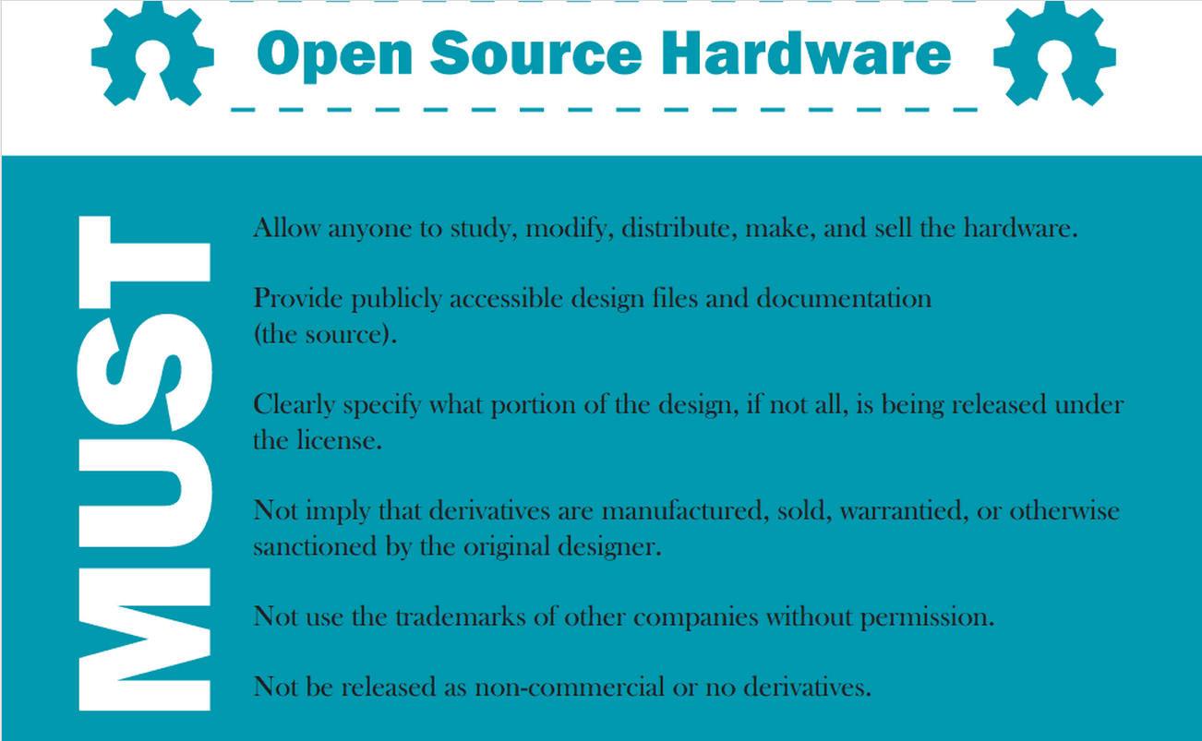

Slide 7
POWERFUL
PRESENTATIONS!
tips & tricks
Notes:
To use this title animation slide with a new image simply 1) move the top semi-transparent shape to the side, 2) delete placeholder image, 3) click on the picture icon to add a new picture, 4) Move semi-transparent shape back to original position, 5) Update text on slide.

Slide 8
FREE – PAID WAR
Hey you are contradicting yourself
Open source software is made up of “K’s” of contributors worldwide and not a single person job, but many a times a part of the general code is released as free where as some may be restricted to some extent.
I said and you read MAY BE
So all of the open source is not free but most free apps come from open source base code.
Whaaaaat….??
So what do we conclude
Well it’s free as long as when end user and also developers are concerned.
Android
For that Linux
Now comes the editor
So does the programmer
Well now people donate(yeah some do).
Customers pay for the software and not the code(come on!)

Slide 9
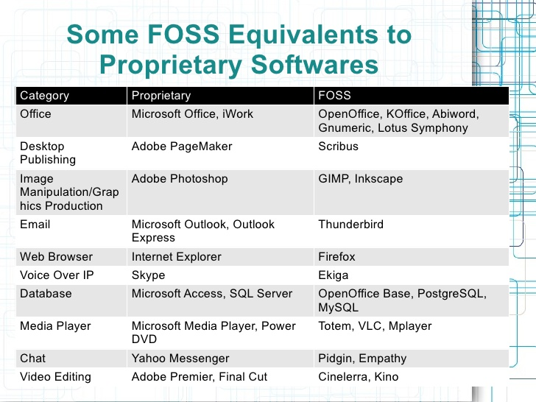

Slide 10
PREPARE
Build your own Open Source way, what are you waiting for open up your laptops now!
“Let’s play a game”
Well encryption matters does it, not so sure or think what do I do such that I would need encryption , well let’s play a game.
Open up codemoji.org
“API – Application Programming Interface”
How to prevent Donkey coding!
“More coding less chit chat”
We will develop a browser extension and an Software Bot , FUN isn’t it!

Slide 11
What even are API’s?
API
Way to code smarter, efficient and stop worrying about “why the heck it isn’t compiling”
!
In computer programming, an application programming interface (API) is a set of subroutine definitions, protocols, and tools for building application software. In general terms, it is a set of clearly defined methods of communication between various software components. A good API makes it easier to develop a computer program by providing all the building blocks, which are then put together by the programmer. An API may be for a web-based system, operating system, database system, computer hardware or software library.

Slide 12
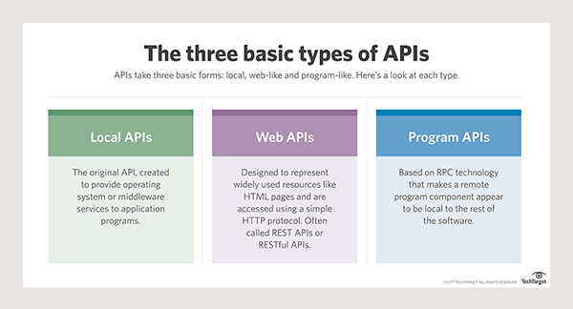

Slide 13

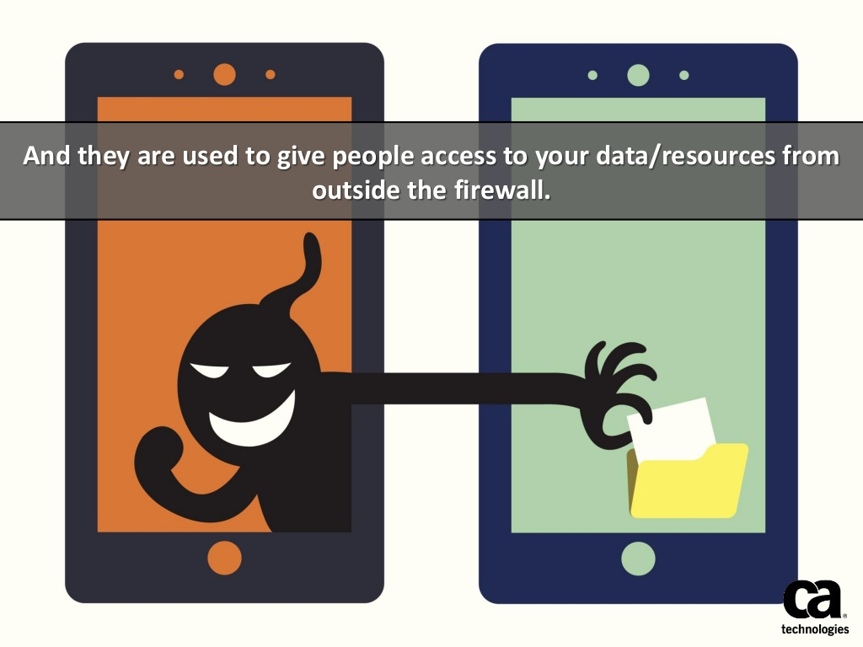

Slide 14
Where will you find them?
$
https://apilist.fun/

Slide 15
THE STAGE HAS BEEN SET Now let’s create a software bot , a chat bot(!)
1
2
3
4
5
So what are chat bots?
How do you deploy a app for it.
Now let’s create a Telegram account and a pythonanywhere.com account.
Let’s put in some tad bits of code to make the bot working.
Chat infinitely and show off among your friends.
Reference : The basics you can find anywhere 5 Steps To Successful Storytelling Published on April 5, 2014 Featured in: Marketing & Advertising

Slide 16
Chat Bots are now used not even to make chatting more relaxing and happy maker way but also to relieve stress and cover up loneliness among elderly, to teach students , carry meetings
FACT

Slide 17
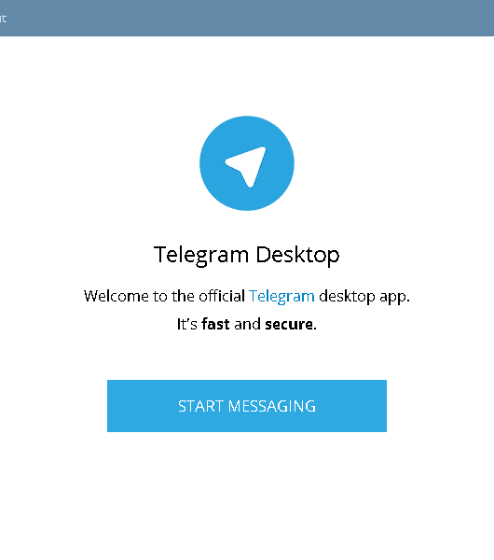
1
Create a Telegram account.
Download
Telegram Desktop

Slide 18
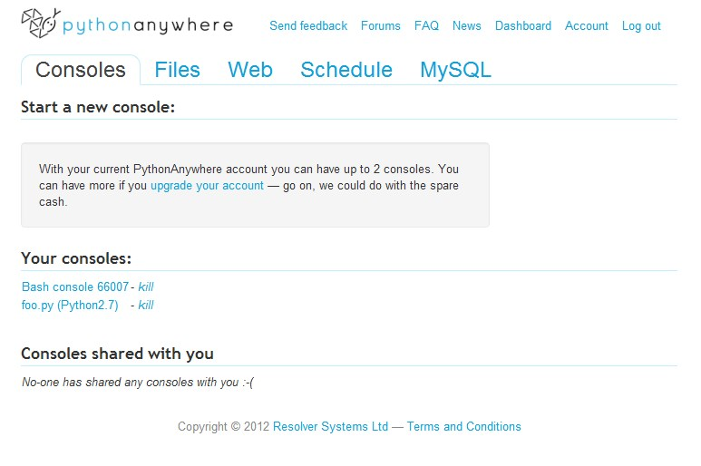
2
Create a Python Cloud account
pythonanywhere.com

Slide 19
Lets Begin Coding
Let’s Code It!
Notes:
Tip:
When using complex image as full-bleed background add a transparency (70%-90%) fill layer to give contrast to text.

Slide 20
How will you contribute?
If you have never contributed to an open source project before and you’re just getting started, consider exploring these resources.
http://up-for-grabs.net is a site that aggregates (rolls up and makes easy to explore) projects that actively want help. They label those projects with things like “up-for-grabs”, “jump-in” or “help wanted.”
Read blog posts and guides on how to contribute to an open source project, then pick one!
If you’re just getting started with tech and are considering being a social developer, we’ve made a documentary training movie for you! Get Involved in Tech walks you through setting up your GitHub account, exploring Stack Overflow, setting up a blog and starting to tweet!
Wondering what someone else’s first contribution was? You can easily find out any GitHub username’s “First Pull Request” .
We think that open source projects should value civility and kindness and be patient with new developers and we encourage you to explore projects that have a published Code of Conduct and we hope you do too!

Slide 21
Mozilla
What can I do for Mozilla?
This site suggests you projects based on the programming skill you select. Once you choose your project, it takes you to the respective Mozilla project.
Bugs Ahoy!
Bugs Ahoy is a site particularly for the new contributors. The website categorizes the ‘Easy bugs’ and ‘Mentored Bugs’ based on the various projects like JS Engine, Dev tools, Firefox OS etc.
Bugs Ahoy also categorizes the easy bugs based on the programming languages too. These are primarily in Python, Java, Shell, JS, C/C++ and HTML/CSS. One can choose a combination of filters to choose the perfect bug to get started.
Contributing to Mozilla is extremely simple , just follow these instructions and soon you will be a developer contributing to Mozilla.

Slide 22
The mentors who can be contacted
Bugzilla page
IRC channel name
List of mentored bugs
Getting Involved Dev Tools – https://wiki.mozilla.org/DevTools/GetInvolved
Getting Involved Mozilla.org - https://wiki.mozilla.org/Webdev/GetInvolved/mozilla.org
Getting Involved AMO - https://wiki.mozilla.org/Webdev/GetInvolved/addons.mozilla.org
Getting Involved SUMO - https://wiki.mozilla.org/Webdev/GetInvolved/support.mozilla.org
Getting Involved MDN - https://wiki.mozilla.org/Webdev/GetInvolved/developer.mozilla.org
Getting Involved Socorro - https://wiki.mozilla.org/Webdev/GetInvolved/crash-stats.mozilla.org
Getting Involved Mozillians - https://wiki.mozilla.org/Webdev/GetInvolved/mozillians.org
Getting Involved ReMo - https://wiki.mozilla.org/Webdev/GetInvolved/reps.mozilla.org
Getting Involved input.mozilla.org - https://wiki.mozilla.org/Webdev/GetInvolved/reps.mozilla.org
Getting Involved careers.mozilla.org -https://wiki.mozilla.org/Webdev/GetInvolved/careers.mozilla.org
Getting Involved QMO - https://quality.mozilla.org/docs/webqa/get-involved/
Here is another link for Bugzilla Mentored Bugs list - https://bugzil.la/sw:mentor

Slide 23
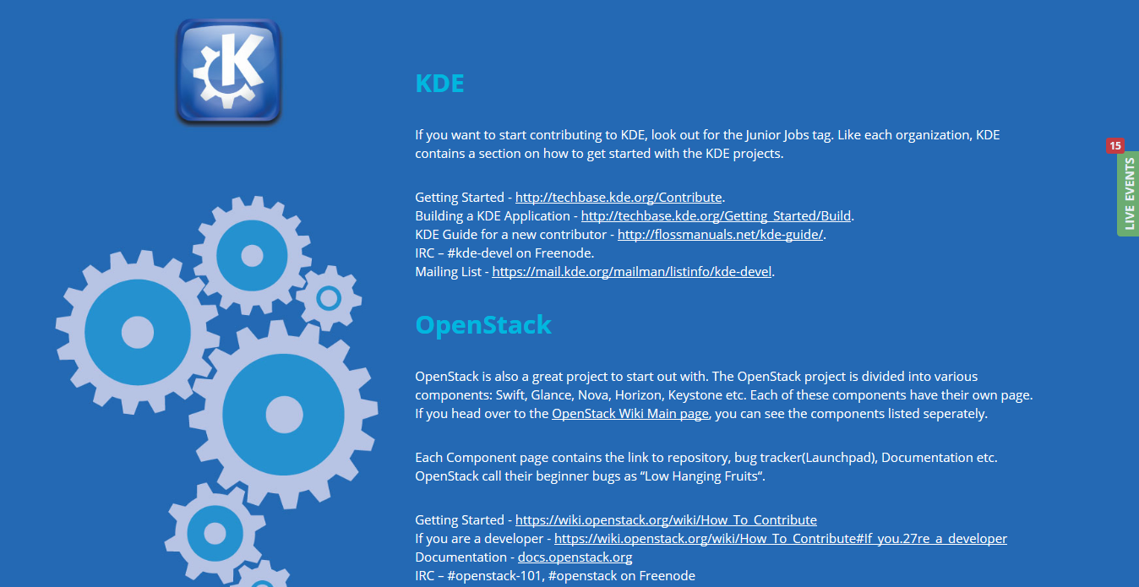

Slide 24
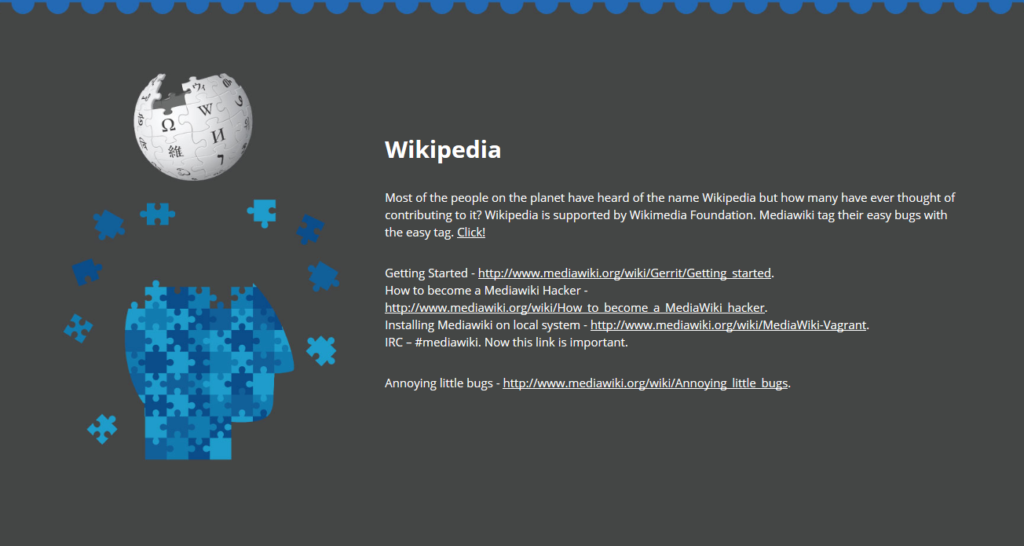

Slide 25
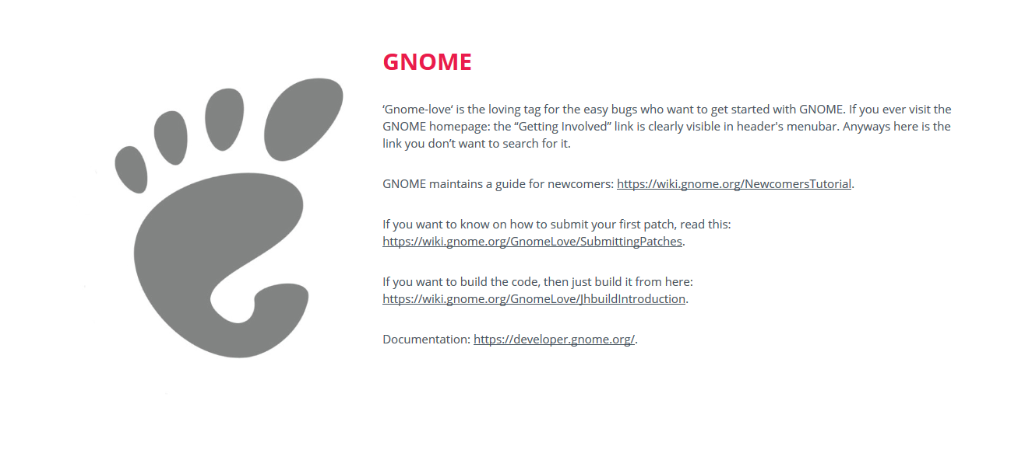

Slide 26
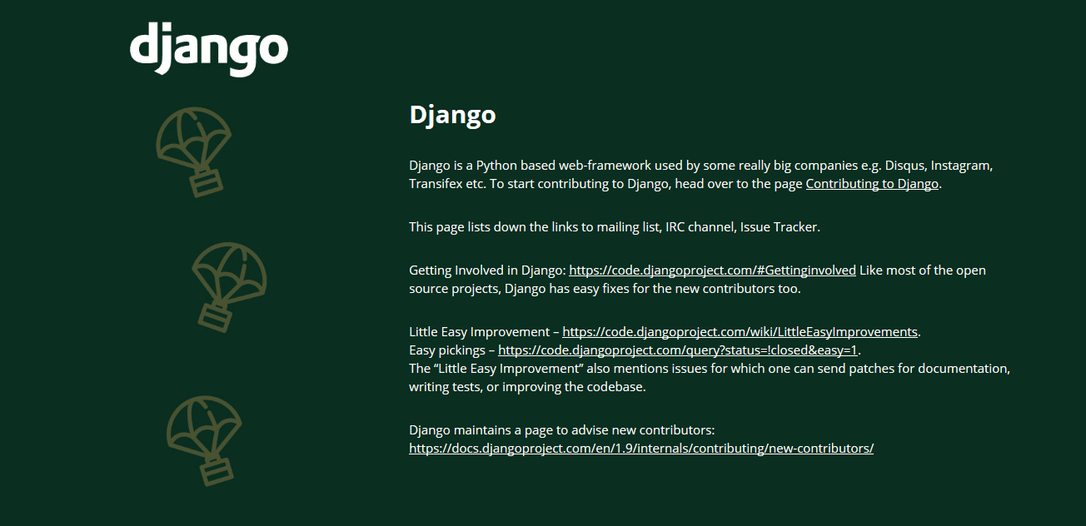

Slide 27
Journey does not end here ,
Look the presenter is telling you something more ☺

Slide 28
Ashwin Phadke
Mozilla Regional Coordinator
FOSS platform contributor
Website: ashwin-Phadke.github.io
Twitter : @ashwinphadke1
Telegram : @AshwinPhadke
Contact : 9860386639
Email : ashwinphadke1@gmail.com

Slide 29
THANK YOU!

